Slide 1
LIVE A-LONG
MINI- PROJECT
A Medical aid that everyone deserves
TEAM: MediMinds

Slide 2
PROBLEM STATEMENT
Limited Access to Medical Expertise:
As over 400 million people worldwide lack access to essential health services, devising a tool for early prediction of various diseases emerges as a critical solution.
Absence of Real-Time Multi-Disease Prediction:
Early stage predictions of diseases such as cancer can significantly reduce the mortality rate to as low as 27%. However, the absence of accessible self-check tools contributes to a high mortality rate.

Slide 3
SOLUTION
Undertaking the development of a multi-disease prediction project.
Incorporating Android and web platforms, and enriching it with Augmented reality (AR) and Virtual reality (VR) visualization of both healthy and affected organs.
Disease prediction revolutionizes early intervention, cost-effective treatment, and personalized care, while AR/VR visualization enriches medical understanding and patient engagement.
This medical technology also explores previously uncharted educational and diagnostic possibilities.
This endeavor aspires to transform the healthcare landscape, making it more proactive, informative, and ultimately, more compassionate.

Slide 4
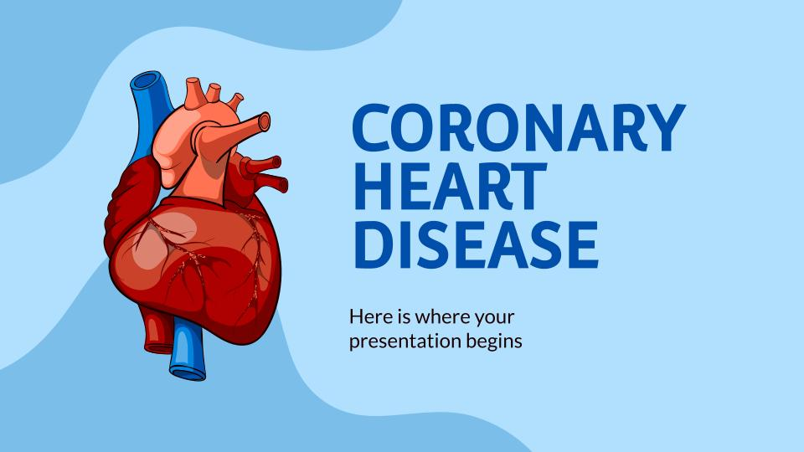
PROJECT SCOPE
The scope of disease prediction within this project encompasses the development of machine learning models capable of early diagnosis and risk assessment for a wide range of diseases.
These models will utilize diverse medical data sources to provide accurate predictions, ultimately empowering proactive healthcare and reducing the burden of preventable diseases.

Slide 5
FLOW CHART
DATASET
PREPROCESSING
WEB
ANDROID
TRAINING
SET
TESTING
SET
EVALUATING
MODELS
MODEL
USER
INPUTS
KNOWLEDGE
PREDICTED DISEASES

Slide 6













TECH-STACKS
AR/VR
ANDROID
MACHINE LEARNING
WEB

Slide 7
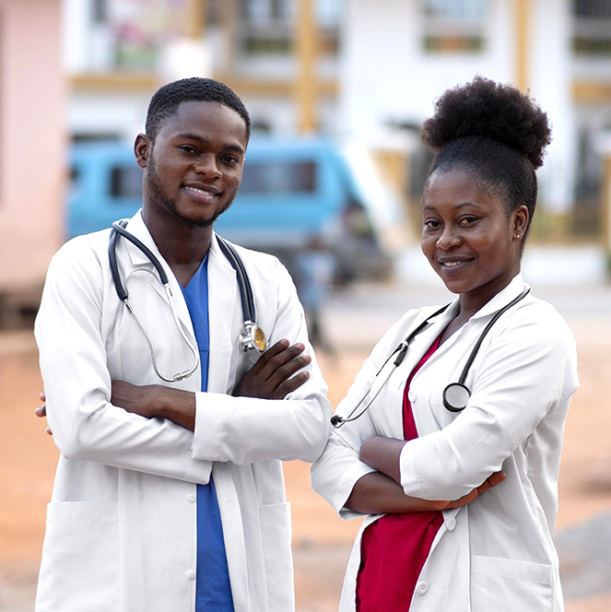
OUR TEAM
PARTH AGRAWAL
ROHIT VERMA
SHUBH AGARWAL
SRISHTI SINGH
SHIPRA MAURYA
SWATANTRA AGARWAL
VAISHNAVI SINGH
Mentor: ARYAN MISHRA

Slide 8
THANK YOU

